Slide 1

Normalization
Lecture 5
UCCD1203
DATABASE DEVELOPMENT AND APPLICATIONS

Slide 2
Design Guidelines for Relational Databases
What is relational database design?
  The grouping of attributes to form "good" relation schemas
Two levels of relation schemas
  The logical "user view" level
  The storage "base relation" level
Design is concerned mainly with base relations
What are the criteria for "good" base relations?

Slide 3
1. Semantics of the Relation Attributes
each tuple in a relation should represent one entity or relationship instance. (Applies to individual relations and their attributes).
Attributes of different entities should not be mixed in the same relation
Only foreign keys should be used to refer to other entities
Entity and relationship attributes should be kept apart as much as possible.

Slide 4
Data redundancy and update anomalies
Major aim of relational database design is to group columns into tables to minimize data redundancy and reduce file storage space required by base tables.

Slide 5
Data redundancy and update anomalies
Tables that contain redundant information may potentially suffer from update anomalies.
3 types of update anomalies include
    Insertion anomalies
    Deletion anomalies
    Modification anomalies

Slide 6
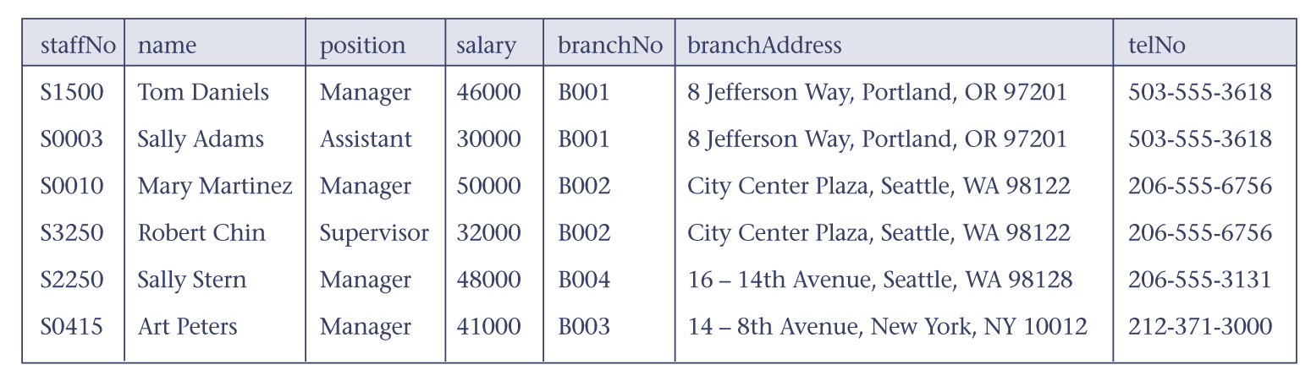
Insertion anomalies
Insert a record for a new staff located in B001, we must also enter the correct details for that branch. Otherwise problem will arise.
To insert a new branch currently has no staff, it is necessary to enter NULLS into the staffNo. This will cause problem because staffNo is a primary key which cannot be null.

Slide 7
Deletion anomalies
Delete a record that represents the last member of staff located at a branch, the details about that branch are lost from the database.
For example, delete the record of staff named Art Peters will result in the lost of details of the branch B003 from the database.
Solution: Separating Staff and Branch tables will solve the problem.

Slide 8
Modification anomalies
To change the value of one attribute (say telNo of B001), we must remember to change all the telNo associated to B001. Otherwise the database will be inconsistent. In this case, B001 will have two different telNo.

Slide 9
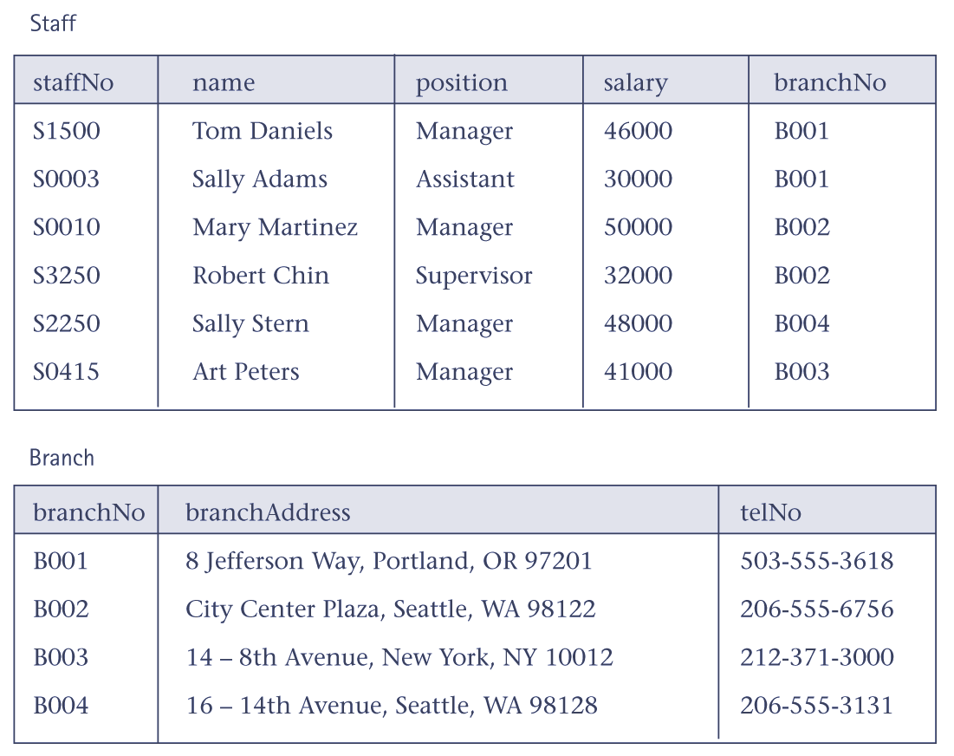
Data redundancy and update anomalies

Slide 10
3 Null Values in Tuples
Relations should be designed such that their tuples will have as few NULL values as possible
Attributes that are NULL frequently could be placed in separate relations (with the primary key)
Reasons for nulls:
  Attribute not applicable or invalid
  Attribute value unknown (may exist)
  Value known to exist, but unavailable

Slide 11
Functional Dependency
Main concept associated with normalization.
Functional Dependency
  A Functional Dependency describes a relationship between attributes within a single relation.
  An attribute is functionally dependent on another if we can use the value of one attribute to determine the value of another.
  If A and B are attributes of relation R, B is functionally dependent on A (denoted A  B), if each value of A in R is associated with exactly one value of B in R.

Slide 12
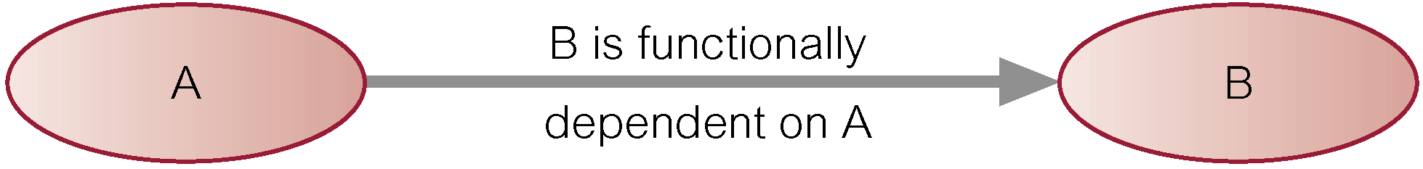
Functional Dependency
Property of the meaning (or semantics) of the attributes in a relation.
Diagrammatic representation:
Determinant of a functional dependency refers to attribute or group of attributes on left-hand side of the arrow.

Slide 13
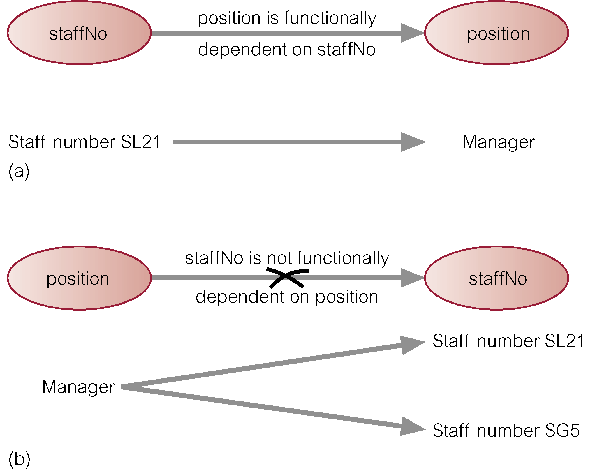
Example - Functional Dependency

Slide 14
Functional Dependency
Main characteristics of functional dependencies used in normalization:
  have a 1:1 relationship between attribute(s) on left and right-hand side of a dependency;
  hold for all time;
  are full functional dependency.

Slide 15
Functional Dependency- Examples
Employee_Name is functionally dependent on Social_Security_Number because Social_Security_Number can be used to uniquely determine the value of Employee_Name.
Here are a few more examples:
Student_ID → Student_Major
Student_ID, CourseNumber, Semester → Grade
Course_Number, Section → Professor, Classroom, NumberOfStudents

Slide 16
Normalization
Main objective in developing a logical data model for relational database systems is to create an accurate representation of the data, its relationships, and constraints.
To achieve this objective, must identify a suitable set of relations.

Slide 17
Stages of Normalization
Unnormalised
(UDF)
Remove repeating groups
First normal form
(1NF)
Remove partial dependencies
Second normal form
(2NF)
Remove transitive dependencies
Third normal form
(3NF)

Slide 18
The Process of Normalization
Formal technique for analyzing a relation based on its primary key and functional dependencies between its attributes.
Often executed as a series of steps. Each step corresponds to a specific normal form, which has known properties.
As normalization proceeds, relations become progressively more restricted (stronger) in format and also less vulnerable to update anomalies.

Slide 19
Unnormalized Normal Form (UNF)
Definition: A relation is unnormalized when it has not had any normalization rules applied to it, and it suffers from various anomalies.
  the capturing of attributes to a ‘Universal Relation’ from a screen layout, manual report, manual document, etc...

Slide 20
ClientRental relation in UNF
Repeating group = (propertyNo, pAddress, rentStart, rentFinish, rent, ownerNo, oName)
Unnormalized form (UNF)
A table that contains one or more repeating groups.
ClientNo | cName | propertyNo | pAddress | rentStart | rentFinish | rent | ownerNo | oName
CR76 | John kay | PG4 PG16 | 6 lawrence St,Glasgow 5 Novar Dr, Glasgow | 1-Jul-00 1-Sep-02 | 31-Aug-01 1-Sep-02 | 350 450 | CO40 CO93 | Tina Murphy Tony Shaw
CR56 | Aline Stewart | PG4 PG36 PG16 | 6 lawrence St,Glasgow 2 Manor Rd, Glasgow 5 Novar Dr, Glasgow | 1-Sep-99 10-Oct-00 1-Nov-02 | 10-Jun-00 1-Dec-01 1-Aug-03 | 350 370 450 | CO40 CO93 CO93 | Tina Murphy Tony Shaw Tony Shaw
Figure ClientRental unnormalized table

Slide 21
First Normal Form (1NF)
Definition: A relation is in 1NF if, and only if, all its underlying attributes contain atomic values only.
  the intersection of each row and column contains one and only one value.
Remove repeating groups into a new relation
1NF disallows having
  a set of values,
  a tuple of values, or
  a combination of both as an attribute value for a single tuple.

Slide 22
First Normal Form (1NF)
There are two approaches to removing repeating groups from unnormalized tables:
  Removes the repeating groups by entering appropriate data in the empty columns of rows containing the repeating data.
  2. Removes the repeating group by placing the repeating data, along with a copy of the original key attribute(s), in a separate relation. A primary key is identified for the new relation.

Slide 23
1NF ClientRental relation with the first approach
With the first approach, we remove the repeating group (property rented details) by entering the appropriate client data into each row.
The ClientRental relation is defined as follows,
ClientRental ( clientNo, propertyNo, cName, pAddress, rentStart, rentFinish, rent, ownerNo, oName)
ClientNo | propertyNo | cName | pAddress | rentStart | rentFinish | rent | ownerNo | oName
CR76 | PG4 | John Kay | 6 lawrence St,Glasgow | 1-Jul-00 | 31-Aug-01 | 350 | CO40 | Tina Murphy
CR76 | PG16 | John Kay | 5 Novar Dr, Glasgow | 1-Sep-02 | 1-Sep-02 | 450 | CO93 | Tony Shaw
CR56 | PG4 | Aline Stewart | 6 lawrence St,Glasgow | 1-Sep-99 | 10-Jun-00 | 350 | CO40 | Tina Murphy
CR56 | PG36 | Aline Stewart | 2 Manor Rd, Glasgow | 10-Oct-00 | 1-Dec-01 | 370 | CO93 | Tony Shaw
CR56 | PG16 | Aline Stewart | 5 Novar Dr, Glasgow | 1-Nov-02 | 1-Aug-03 | 450 | CO93 | Tony Shaw

Slide 24
1NF ClientRental relation with the second approach
With the second approach, we remove the repeating group (property rented details) by placing the repeating data along with a copy of the original key attribute (clientNo) in a separte relation.
ClientNo | cName
CR76 | John Kay
CR56 | Aline Stewart
Client (clientNo, cName)
PropertyRentalOwner (clientNo, propertyNo, pAddress, rentStart, rentFinish, rent, ownerNo, oName)
ClientNo | propertyNo | pAddress | rentStart | rentFinish | rent | ownerNo | oName
CR76 | PG4 | 6 lawrence St,Glasgow | 1-Jul-00 | 31-Aug-01 | 350 | CO40 | Tina Murphy
CR76 | PG16 | 5 Novar Dr, Glasgow | 1-Sep-02 | 1-Sep-02 | 450 | CO93 | Tony Shaw
CR56 | PG4 | 6 lawrence St,Glasgow | 1-Sep-99 | 10-Jun-00 | 350 | CO40 | Tina Murphy
CR56 | PG36 | 2 Manor Rd, Glasgow | 10-Oct-00 | 1-Dec-01 | 370 | CO93 | Tony Shaw
CR56 | PG16 | 5 Novar Dr, Glasgow | 1-Nov-02 | 1-Aug-03 | 450 | CO93 | Tony Shaw

Slide 25
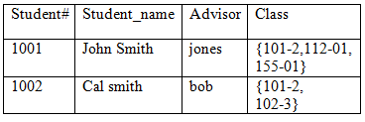
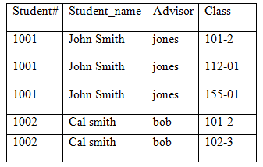
Other Example

Slide 26
Second Normal Form (2NF)
A database table is said to be in 2NF if
  it is in 1NF and
  contains only those fields/columns that are functionally dependent on the primary key.
In 2NF the partial dependencies can be removed of any non-key field.
Note:
  It is still possible for a table in 2NF to exhibit transitive dependency; that is, one or more attributes may be functionally dependent on nonkey attributes.

Slide 27
The process of converting the database table into 2NF:
Identify the primary key for the 1NF relation.
Identify the functional dependencies in the relation.
If partial dependencies exist on the primary key remove them by placing then in a new relation along with a copy of their determinant.

Slide 28
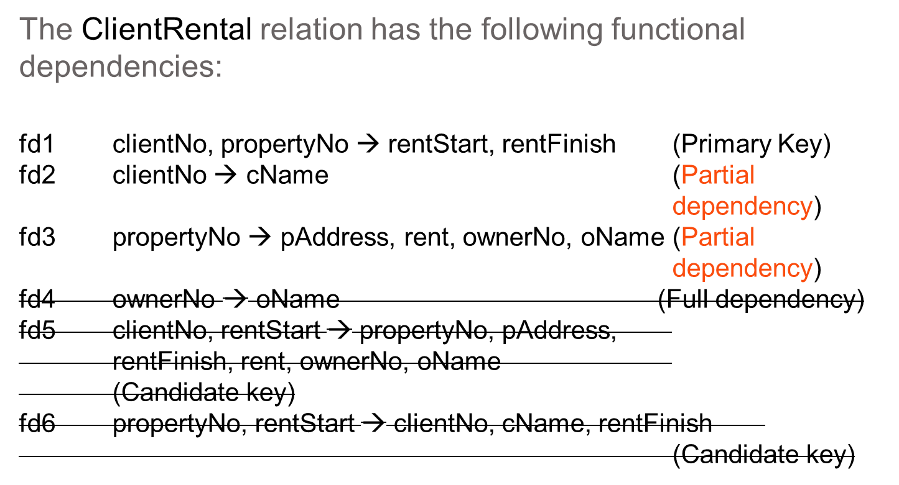
2NF ClientRental relation

Slide 29
2NF ClientRental relation
After removing the partial dependencies, the creation of the three new relations called Client, Rental, and PropertyOwner
Client (clientNo, cName)
Rental (clientNo, propertyNo, rentStart, rentFinish)
PropertyOwner (propertyNo, pAddress, rent, ownerNo, oName)
Rental
Client
ClientNo | propertyNo | rentStart | rentFinish
CR76 | PG4 | 1-Jul-00 | 31-Aug-01
CR76 | PG16 | 1-Sep-02 | 1-Sep-02
CR56 | PG4 | 1-Sep-99 | 10-Jun-00
CR56 | PG36 | 10-Oct-00 | 1-Dec-01
CR56 | PG16 | 1-Nov-02 | 1-Aug-03
ClientNo | cName
CR76 | John Kay
CR56 | Aline Stewart
PropertyOwner
propertyNo | pAddress | rent | ownerNo | oName
PG4 | 6 lawrence St,Glasgow | 350 | CO40 | Tina Murphy
PG16 | 5 Novar Dr, Glasgow | 450 | CO93 | Tony Shaw
PG36 | 2 Manor Rd, Glasgow | 370 | CO93 | Tony Shaw
Figure 2NF ClientRental relation

Slide 30
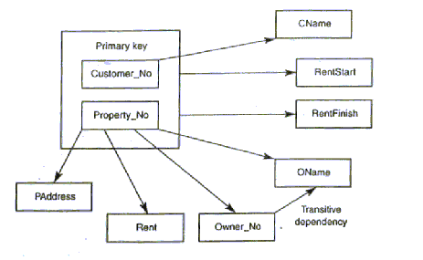
Third Normal Form (3NF)
A condition where A, B, and C are attributes of a relation such that
if A → B and B → C, then C is transitively dependent on A via B
(provided that A is not functionally dependent on B or C).

Slide 31
Third normal form (3NF)
A relation that is in first and second normal form, and in which no non-primary-key attribute is transitively dependent on the primary key.
The normalization of 2NF relations to 3NF involves the removal of transitive dependencies by placing the attribute(s) in a new relation along with a copy of the determinant.

Slide 32
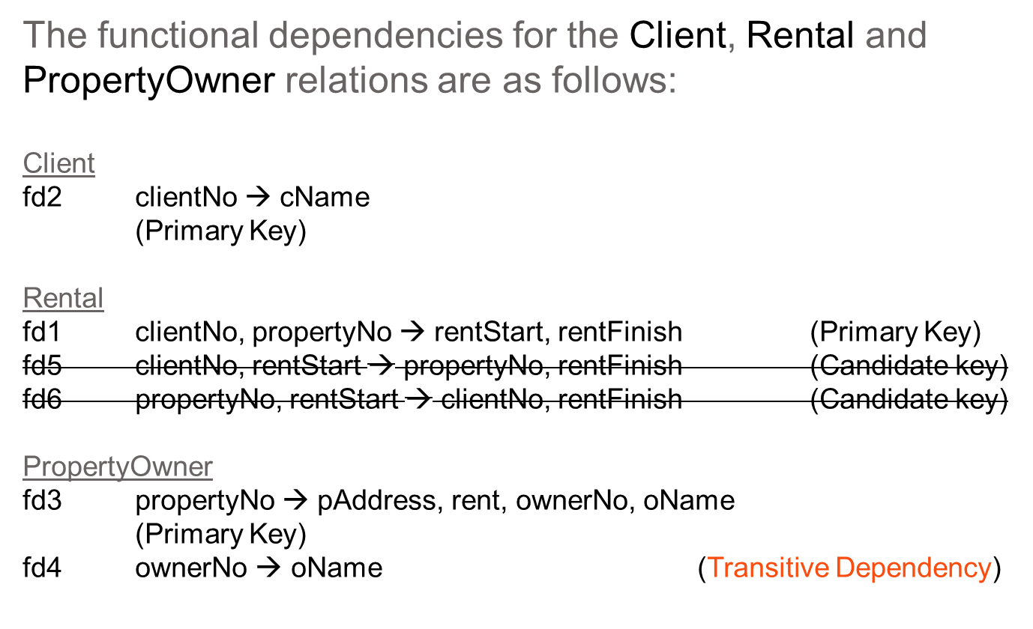
3NF ClientRental relation

Slide 33
3NF ClientRental relation
The resulting 3NF relations have the forms:
Client (clientNo, cName)
Rental (clientNo, propertyNo, rentStart, rentFinish)
PropertyOwner (propertyNo, pAddress, rent, ownerNo)
Owner (ownerNo, oName)

Slide 34
3NF ClientRental relation
Client
Rental
ClientNo | cName
CR76 | John Kay
CR56 | Aline Stewart
ClientNo | propertyNo | rentStart | rentFinish
CR76 | PG4 | 1-Jul-00 | 31-Aug-01
CR76 | PG16 | 1-Sep-02 | 1-Sep-02
CR56 | PG4 | 1-Sep-99 | 10-Jun-00
CR56 | PG36 | 10-Oct-00 | 1-Dec-01
CR56 | PG16 | 1-Nov-02 | 1-Aug-03
PropertyOwner
propertyNo | pAddress | rent | ownerNo
PG4 | 6 lawrence St,Glasgow | 350 | CO40
PG16 | 5 Novar Dr, Glasgow | 450 | CO93
PG36 | 2 Manor Rd, Glasgow | 370 | CO93
Owner
ownerNo | oName
CO40 | Tina Murphy
CO93 | Tony Shaw
Figure 3NF ClientRental relation

Slide 35
Additional Example
Consider the following relation/table:
CustID | CustName | Cust_City | ProdID | ProdName | UnitPrice | Quant | SupplierID
C123 C123 C123 C456 C911 C911 C528 | Alan Alan Alan Peter Mike Mike Tom | KL KL KL KL PG PG JH | P1 P2 P3 P1 P2 P3 P1 | Rice C Rice A Rice B Rice C Rice A Rice B Rice C | 29.90 45.00 35.80 29.90 45.00 35.80 29.90 | 100 50 80 30 100 80 60 | S1 S2 S3 S1 S2 S3 S1
What is the Primary Key of the relation?
How about Foreign Key?
Is the table in 1NF or 2NF, 3NF or UNF?

Slide 36
Example
UNF
A (CustID, CustName, Cust_City, {ProdID, ProdName, UnitPrice, Quant, SupplierID})
1NF
A (CustID, CustName, Cust_City)
B (CustID, ProdID, ProdName, UnitPrice, Quant, SupplierID)
2NF
A (CustID, CustName, Cust_City)
B (CustID, ProdID, Quant)
C (ProdID, ProdName, UnitPrice, SupplierID)
3NF
= 2NF

Slide 37
Example
1NF
A (CustID, CustName, Cust_City, ProdID, ProdName, UnitPrice, Quant, SupplierID)
2NF
A (CustID, CustName, Cust_City)
B (CustID, ProdID, Quant)
C (ProdID, ProdName, UnitPrice, SupplierID)
3NF
A (CustID, CustName, Cust_City)
B (CustID, ProdID, Quant)
C (ProdID, ProdName, UnitPrice, SupplierID)
= 2NF

Slide 38
Example
Consider the following relation/table:
CustID | CustName | Cust_City | ProdID | ProdName | UnitPrice | Quant | SupplierID
C123 C456 C911 C528 | Alan Peter Mike Tom | KL KL PG JH | P1 P2 P3 P1 P2 P3 P1 | Rice C Rice A Rice B Rice C Rice A Rice B Rice C | 29.90 45.00 35.80 29.90 45.00 35.80 29.90 | 100 50 80 30 100 80 60 | S1 S2 S3 S1 S2 S3 S1
Suppose we add more attributes about supplier into the table such as S_Name, S_City, S_Tel, then the UNF will be:
A(CustID, CustName, Cust_City, {ProdID, ProdName, UnitPrice, Quant, SupplierID, S_Name, S_City, S_Tel})

Slide 39
Example: Transitive Dependency
1NF
A (CustID, CustName, Cust_City)
B (CustID, ProdID, ProdName, UnitPrice, Quant, SupplierID, S_Name, S_City, S_Tel)
2NF
A (CustID, CustName, Cust_City)
B (CustID, ProdID, Quant)
C (ProdID, ProdName, UnitPrice, SupplierID, S_Name, S_City, S_Tel)
3NF
A (CustID, CustName, Cust_City)
B (CustID, ProdID, Quant)
C (ProdID, ProdName, UnitPrice, SupplierID)
D (SupplierID, S_Name, S_City, S_Tel)

Slide 40

Boyce-Codd Normal Form (BCNF)
A relation is in BCNF if every determinant is a candidate key.
For a relation with only one candidate key , 3NF and BCNF are equivalent.
Violation of BCNF is rare, may occur in a relation that contains two (or more) composite candidate keys and which overlap, that is share at least one attribute in common.
Non primary key attribute determines part of the primary key attribute.
Converting to BCNF:
Step 1: Make the determinant that is not a candidate key to become a component of the Primary Key of the revised table.
Step 2: Decomposed the relation to eliminate the partial dependency.
|-UCCD2203-|

Slide 41
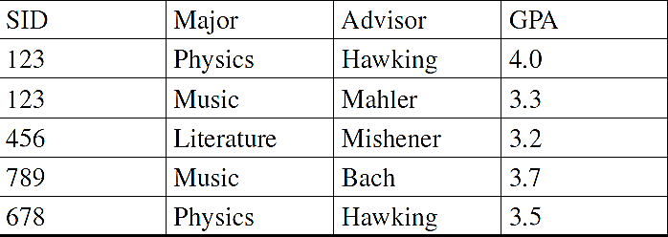
Student_Advisor – is the table in 3NF?
A given student may have more than one major, for each major a student has exactly one advisor and one GPA.
A major may have several faculty members as advisers.
Each advisor advises in exactly one major.
|-UCCD2203-|

Slide 42
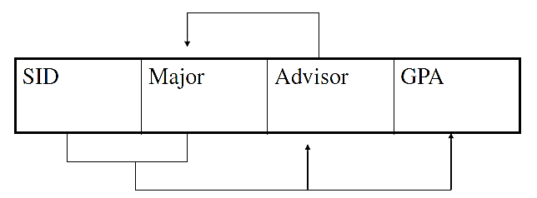
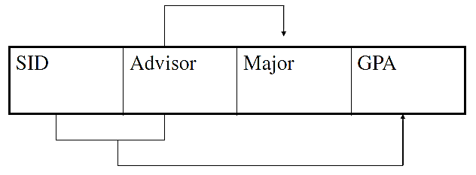
Converting to BCNF
SID, Major → GPA, Advisor
Advisor → Major
SID, Advisor→ GPA,
Advisor → Major
|-UCCD2203-|

Slide 43
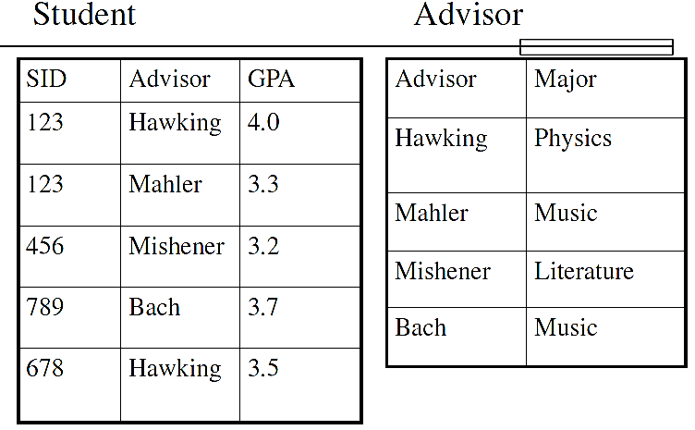
Tables in BCNF
|-UCCD2203-|

Slide 44
Fourth Normal Form
An entity type is in 4NF if it is in 3NF/BCNF and there are no multivalued dependencies between its attribute types.
Any entity type in 3NF is transformed to 4NF:
Detect any multivalued dependencies.
Decompose entity type.
Multi-valued Dependency (MVD):
Represent a dependency between attributes (eg. A, B, C) in a relation, such that for each value of A there is a set of values for B and a set for C. However, the set of values for B and C are independent of each other.
  A -->>B
  A-->>C
|-UCCD2203-|

Slide 45
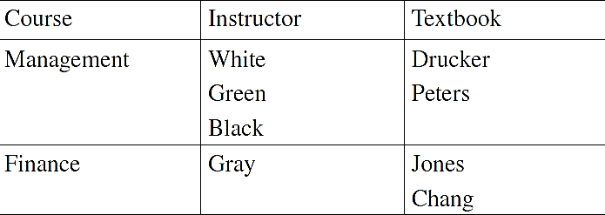
Multivalued Dependencies
Each course has a well-defined set of instructor (mgmt has 3 instructors)
Each course has a well-defined set of textbooks that are used (Finance has 2 textbooks)
The textbooks that are used for a given course are independent of the instructor of the course (the same two textbooks are used for mgmt regardless of which the three instructors is teaching mgmt)
|-UCCD2203-|

Slide 46
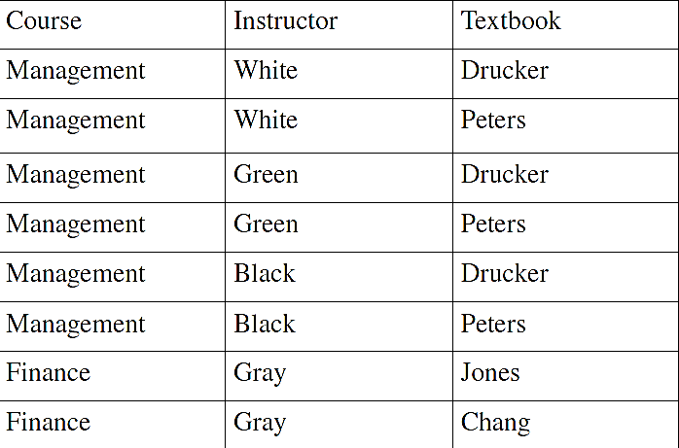

Converting to 4th Normal Form
|-UCCD2203-|

Slide 47
Normalization Example (Project_Detail) - Unnormalized Form (UNF)
Assume that Project Budget can be determined by Project Manager.
  It will be 1 to 1 relationship in BCNF.
The Project_Detail base relation has the dependency to the following attributes:
Project_Detail (Project_Code, Project_Title, Project_Manager, Project_Budget, Employee_No, Employee_Name, Department_No, Department_Name, Hourly_Rate)
|-UCCD2203-|

Slide 48

Project_Detail Unnormalized Form (UNF)
|-UCCD2203-|

Slide 49
Normalization Example (Project_Detail)
First Normal Form (1NF): Determine the keys to uniquely identify each row.
Project_Detail (Project_Code, Project_Title, Project_Manager, Project_Budget, Employee_No, Employee_Name, Department_No, Department_Name, Hourly_Rate)
Second Normal Form (2NF):
Project (Project_code, Project_Title, Project_Manager, Project_Budget)
Project_Detail (Project_Code*, Employee_No*, Hourly_Rate)
Employee (Employee_No, Employee_Name, Department_No, Department_Name)
Third Normal Form (3NF):
Project (Project_code, Project_Title, Project_Manager, Project_Budget)
Project_Detail (Project_Code*, Employee_No*, Hourly_Rate)
Employee (Employee_No, Employee_Name, Department_No*)
Department (Department_No, Department_Name)
|-UCCD2203-|

Slide 50
Normalization Example (Project_Detail)
- Boyce-Codd Normal Form (BCNF)
Boyce-Codd Normal Form (BCNF):
Assume that Project Budget can be determined by Project Manager: Every determinant is a candidate key.
  Project (Project_code, Project_Title, Project_Manager* )
  Budget (Project_Manager, Project_Budget)
  Project_Detail (Project_Code, Employee_No, Hourly_Rate)
  Employee (Employee_No, Employee_Name, Department_No*)
  Department (Department_No, Department_Name)
|-UCCD2203-|

Slide 51
Normalization Example (Project_Detail)
- Dependencies
Full Dependencies:
Project_Code, Employee_No → Project_Title, Project_Manager, Project_Budget, Employee_Name, Department_No, Department_Name, Hourly_Rate
Partial Dependencies:
Project_Code, → Project_Title, Project_Manager, Project_Budget
Employee_No → Employee_Name, Department_No, Department_Name
Transitive Dependencies:
Department_No →, Department_Name
|-UCCD2203-|

Slide 52
De-Normalized Designs
When a normalized design is unnatural, awkward, or results in unacceptable performance, a de-normalized design is preferred. Example:
Normalized relation:
  CUSTOMER (CustNumber, CustName, Zip)
  CODES (Zip, City, State)
De-Normalized relations:
  CUSTOMER (CustNumber, CustName, City, State, Zip)
|-UCCD2203-|

Slide 53
Advantages and Disadvantages of De-Normalization
Advantages - improve performance by:
Pre-computing derived data.
Minimizing the need for joins.
Reducing the number of foreign keys in relations.
Reducing the number of indexes (thereby saving storage space).
Reducing the number of relations.
Disadvantages:
May speed up retrievals but can slow down updates.
Can increase the size of relations.
May simplify implementation in some cases but may make it more complex in others.
Sacrifices flexibility.
|-UCCD2203-|

Slide 54
Methods of De-normalization
Possible ways:
Reduce joins.
Introducing repeating groups.
Combining 1:1 relationships.
Merging lookup tables with base relation.
Creating extract tables.
Duplicating foreign key attributes in 1:* relationships.
|-UCCD2203-|

Slide 55
Conclusions
Data Normalization is a bottom-up technique that ensures the basic properties of the relational model
  no duplicate tuples
  no nested relations
Data normalization is often used as the only technique for database design - implementation view
A more appropriate approach is to complement conceptual modelling with data normalization
|-UCCD2203-|

